Slide 1
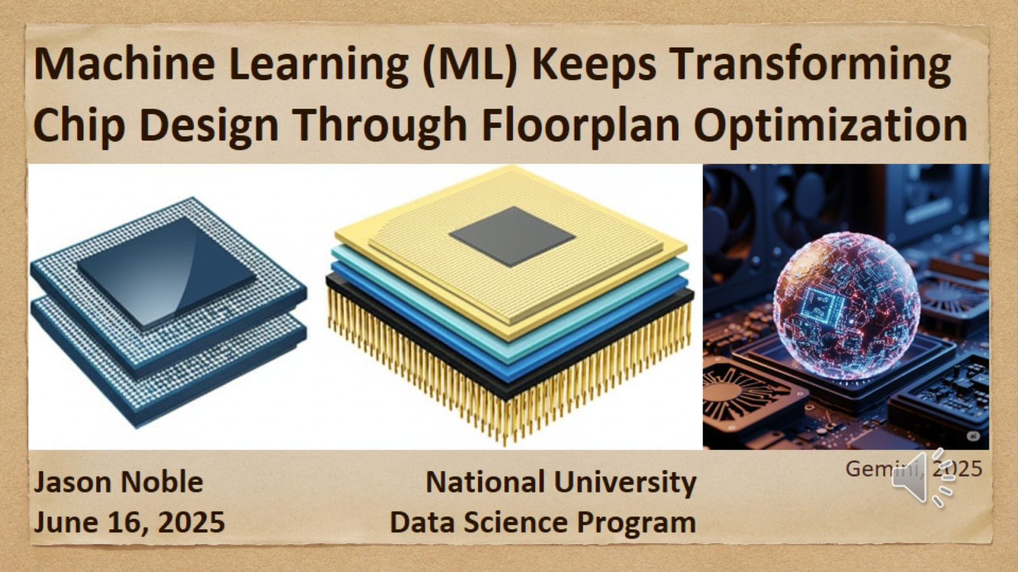
Machine Learning (ML) Keeps Transforming Chip Design Through Floorplan Optimization

Slide 2
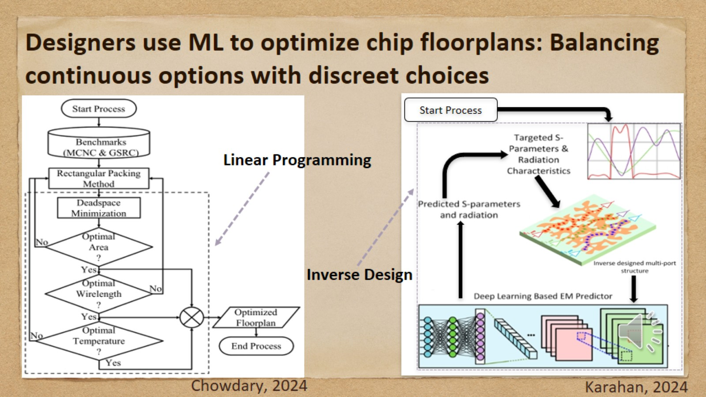
Designers use ML to optimize chip floorplans: Balancing continuous options with discreet choices

Slide 3
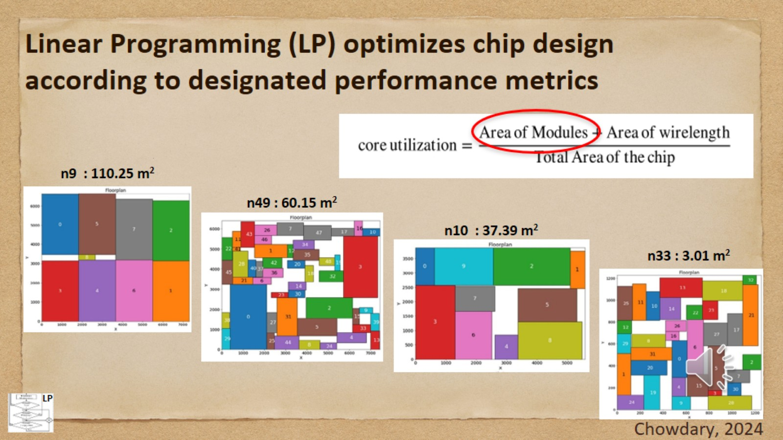
Linear Programming (LP) optimizes chip design according to designated performance metrics

Slide 4
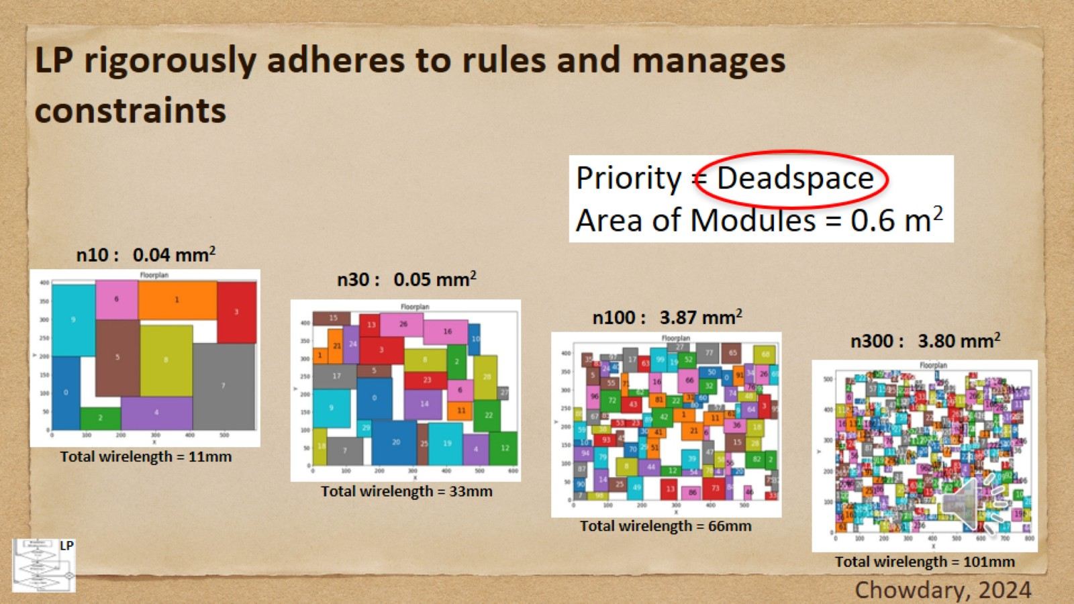
LP rigorously adheres to rules and manages constraints

Slide 5
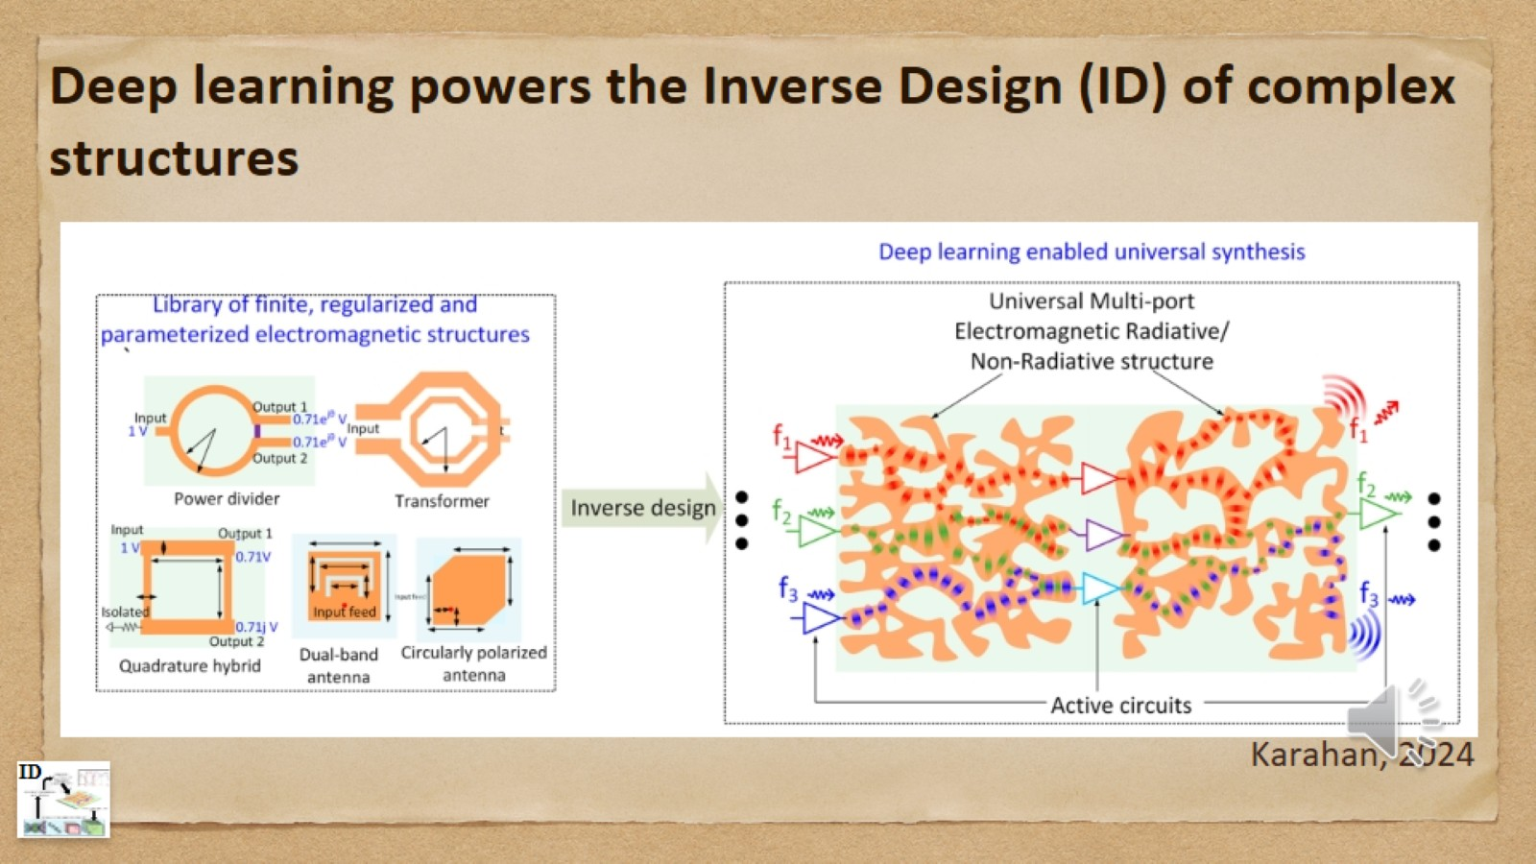
Deep learning powers the Inverse Design (ID) of complex structures

Slide 6
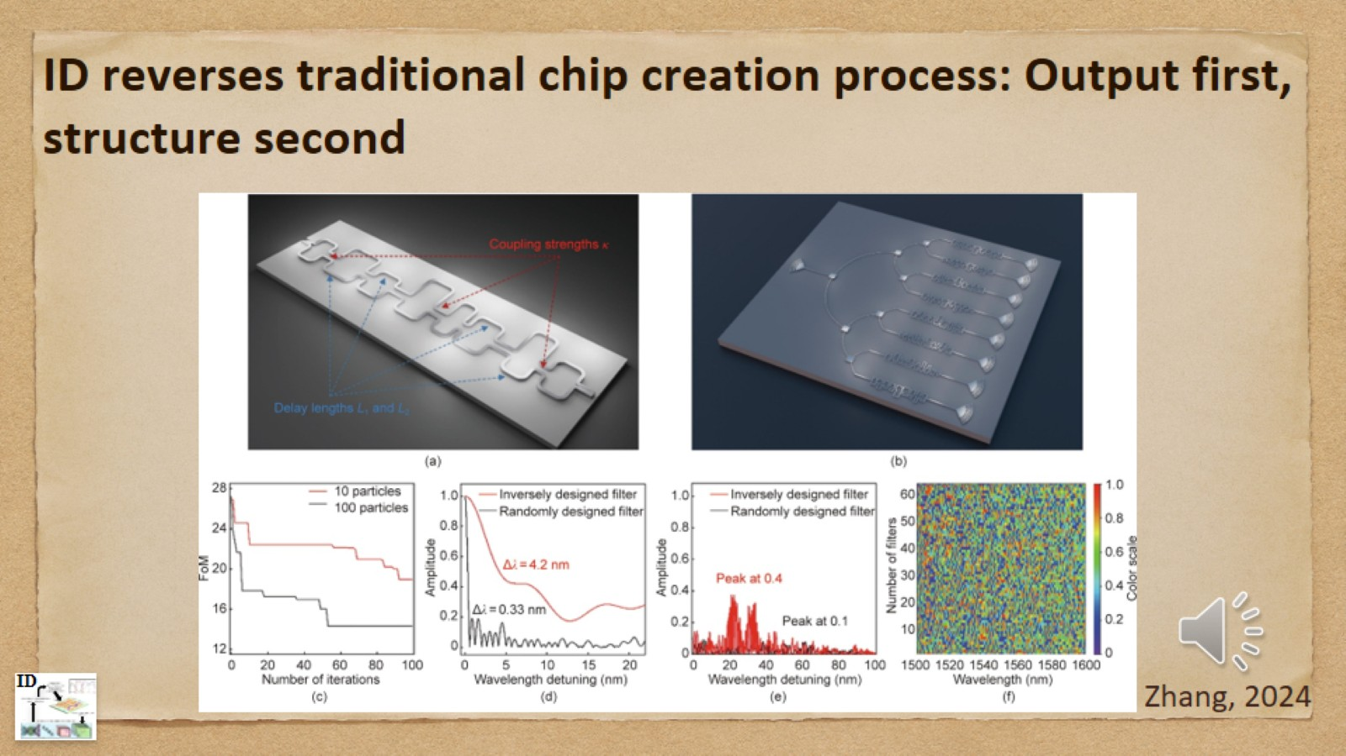
ID reverses traditional chip creation process: Output first, structure second

Slide 7
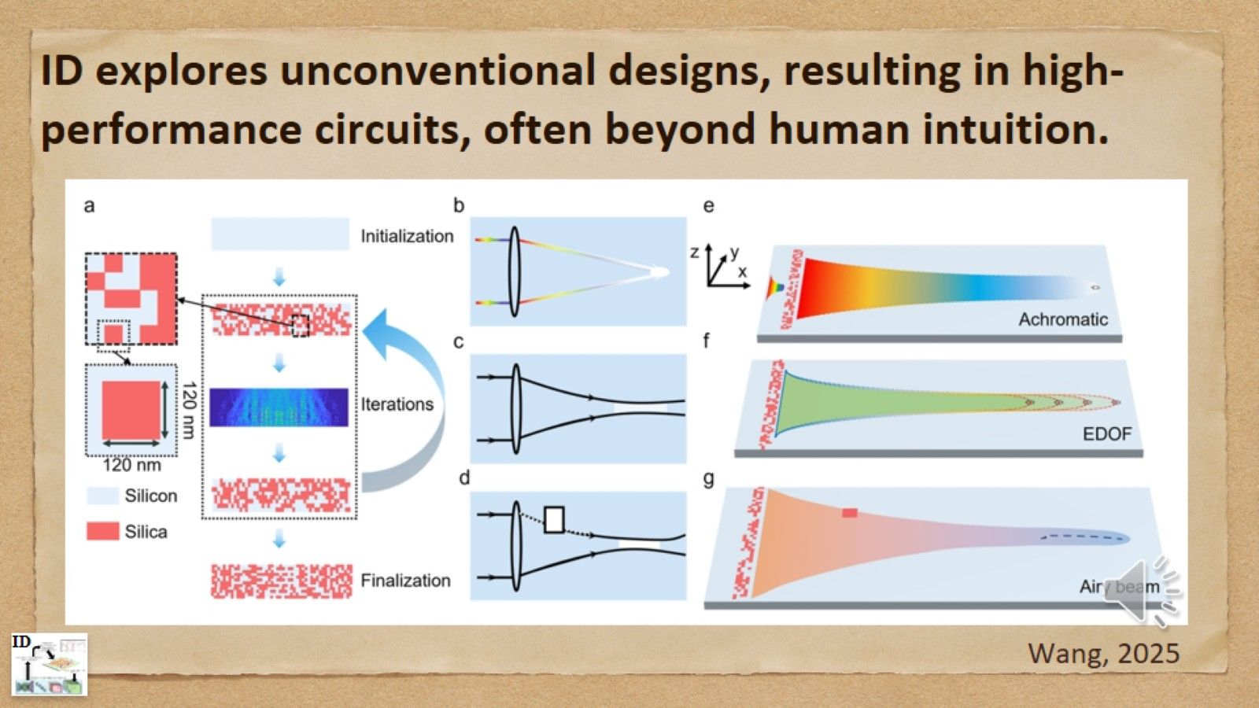
ID explores unconventional designs, resulting in high- performance circuits, often beyond human intuition.

Slide 8
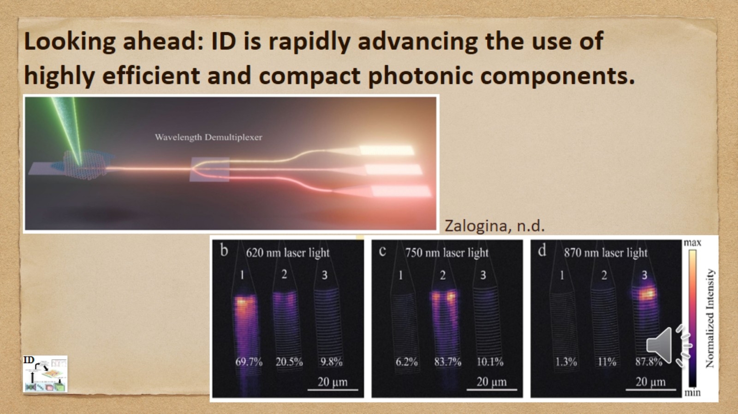
Looking ahead: ID is rapidly advancing the use of highly efficient and compact photonic components.

Slide 9
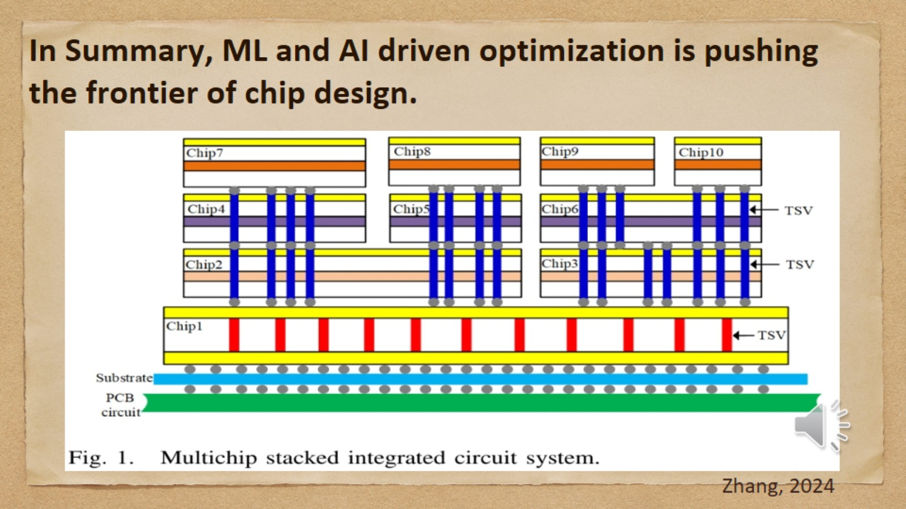
In Summary, ML and AI driven optimization is pushing the frontier of chip design.

Slide 10
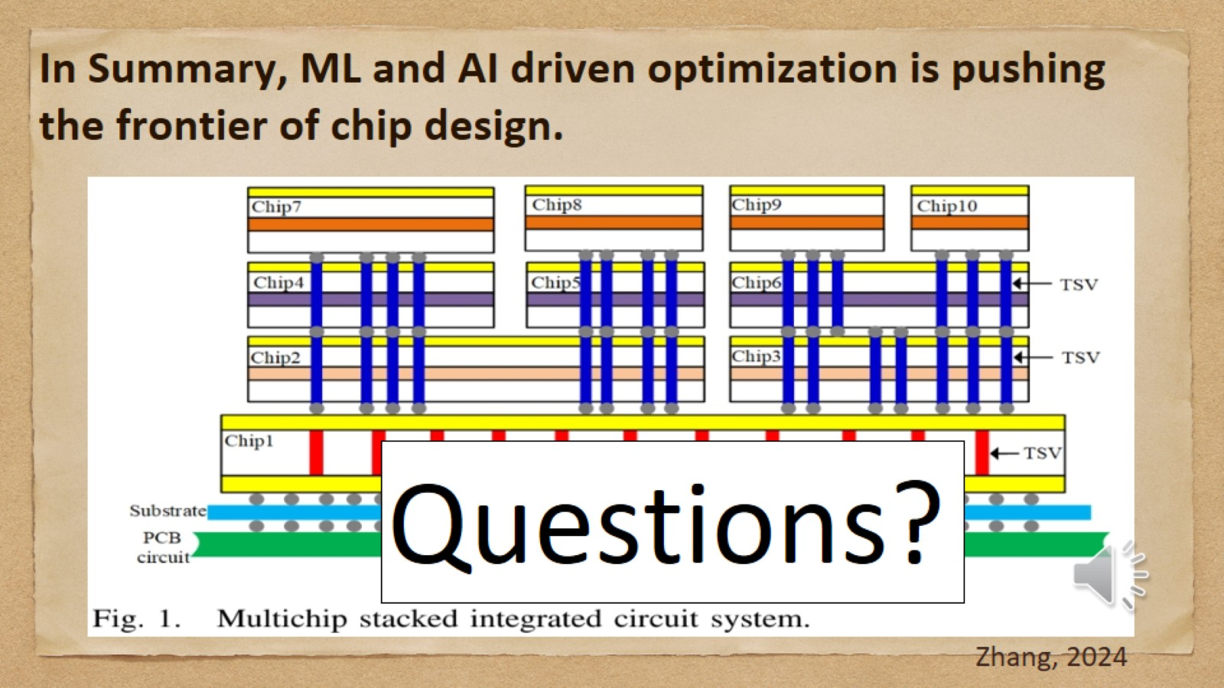
In Summary, ML and AI driven optimization is pushing the frontier of chip design.

Slide 11
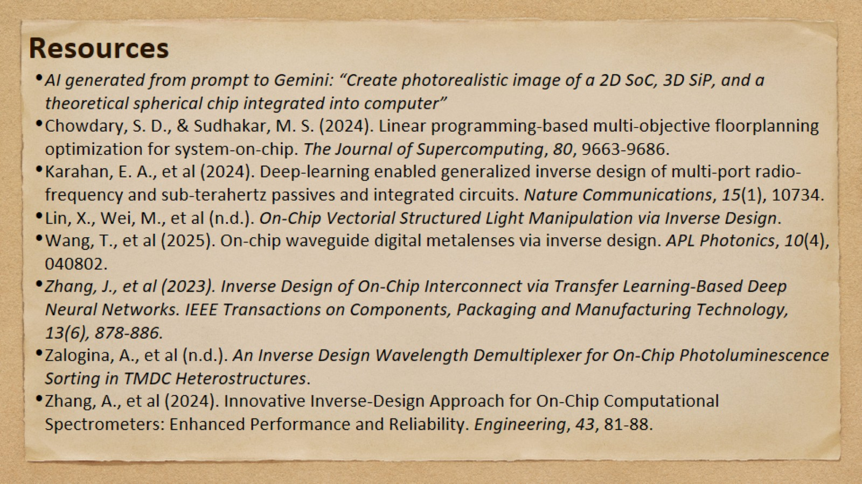
Resources

